Slide 1
Introduction to Programming Language

Slide 2
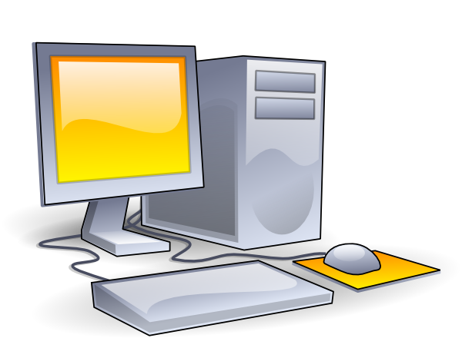
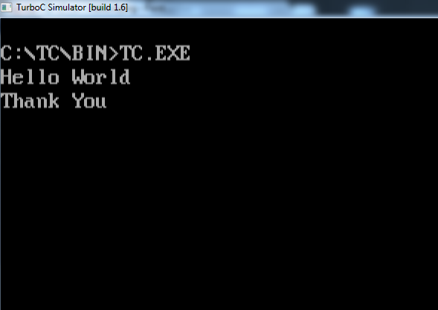

What is Programming?
Programming is a creative process done by programmers to instruct a computer on how to do a task.
Input
Output

Slide 3
What is Program?
A computer program is a set of instructions for a computer to perform a specific task.
Input
Program

Slide 4
Why Programming Language?
A programming language is a formal constructed language designed to communicate instructions to a machine, particularly a computer.

Slide 5


Programing Languages
Gujarati
Hindi
English
And many more……
010100011010
101011100000
101010101010
001110101010
(Machine Language)

Slide 6
Programing Languages
Programing
Languages
Assembly Language
C
Java
(and more than 100)
Gujarati
Hindi
English
And many more……
010100011010
101011100000
101010101010
001110101010
(Machine Language)

Slide 7
Examples
.model small
.data
opr1 dw 1234h
opr2 dw 0002h
.code
mov ax,@data
mov ds,ax
mov ax,opr1
mov bx,opr2
clc
add ax,bx
mov di,offset result
mov [di], ax
mov ah,09h
mov dx,offset result
end
Programing
Languages
Assembly Language
C
Java
(Low Level Language)

Slide 8
Examples
Programing
Languages
void main()
{
int opr1,opr2;
opr1=4660;
opr2=2;
result=opr1+opr2;
}
Assembly Language
C
Java
(Middle Level Language)

Slide 9
Examples
Programing
Languages
class Sum{
public static void main(String arg[])
{
int opr1,opr2;
opr1=4660;
opr2=2;
result=opr1+opr2;
}
}
Assembly Language
C
Java
(High Level Language)

Slide 10

Translator
Translator
Programing
Languages
Assembly Language
C
Java
Assembler
Machine
Language
Compiler
Interpreter

Slide 11


Difference between Compiler and Interpreter
Compiler
Program
Machine Code
010100011010
101011100000
101010101010
001110101010
Output

Slide 12
Difference between Compiler and Interpreter
Interpreter
Program

Slide 13
Difference between Compiler and Interpreter
Interpreter
Program
opr1=4660;
01010001
opr2=2;
result=opr1+opr2;
Output

Slide 14
What’s the benefits?
Compiler
Translates program code into machine code and stores the translated machine code. Than that machine code runs.
Interpreter
Translates your code into machine code and run it in real time.
Faster in execution
Slower in execution
Machine Dependent
Machine Independent

Slide 15
That’s all

